Slide 1
Static Electricity
By Anthony & Braden

Slide 2
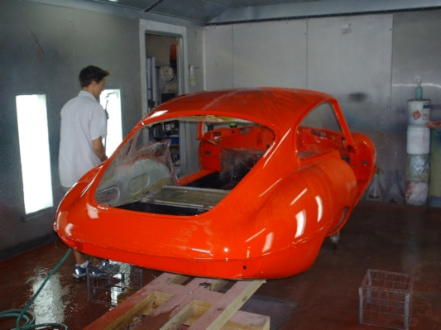
Car companies use static electricity to paint cars.
http://bobandjeannie.com/tnRedpaint1.jpg

Slide 3
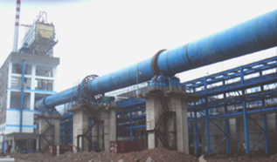
Some factories use static electricity to cut down pollution.
http://www.shanbao-china.com/eng/edit/UploadFile/20084715427159.jpg

Slide 4
When a gasoline truck fills its tanks they are very careful. Because the tank can cause static electricity.
http://utahscience.oremjr.alpine.k12.ut.us/sciber02/Elem/5th/Elect/Elect5/elect5.htm

Slide 5
When water drops rub together in clouds, it makes Lightning which is static electricity.
http://utahscience.oremjr.alpine.k12.ut.us/sciber02/Elem/5th/Elect/Elect5/elect5.htm

Slide 6
When water drops rub together in clouds, it makes lightning which is static electricity.
http://www.edward-weston.com/images/Cara_Weston/clouds2/Rain%20clouds%203.jpg

Slide 7
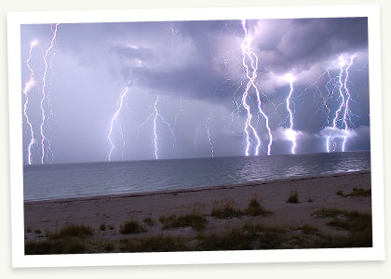
Many people think static electricity is scary because it can burn and shock people and burn your skin.
http://www.swfwmd.state.fl.us/education/kids/lightning.jpg

Slide 8
Bibliography
Ochsenbein, K. (2002, March 1). Static Uses and Abuses. Retrieved September 22, 2009, from What a Shock!: http://utahscience.oremjr.alpine.k12.ut.us/sciber02/Elem/5th/Elect/Elect5/elect5.htm

